Slide 1
CT5102: Programming for Data Analytics Week 11: Introduction to ggplot
https://github.com/JimDuggan/CT5102
Dr. Jim Duggan,
Information Technology,
School of Engineering & Informatics

Slide 2

Overview
Name based on Leland Wilkinson’s grammar of graphics, which provides a formal, structured perspective on how to describe data graphics
ggplot package developed by Hadley Wickham
Data must be stored in data frames
http://www.cookbook-r.com/Graphs/

Slide 3
Terminology
The data is what we want to visualise. It consists of variables, which are stored as columns in the data frame. The data should be in tidy data format.
Geoms are the geometric objects that are drawn to represent the data, such as bars, lines and points
Aesthetic attributes are visual properties of geoms, such as x and y position, line colour, point shapes etc.
Mappings from data values to aesthetics
Scales that control the mappings from values in the data space to values in the aesthetic space.
Guides, for example, tick marks and labels on an axis.

Slide 4
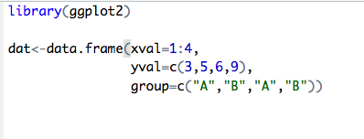
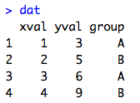
(1) A simple example

Slide 5
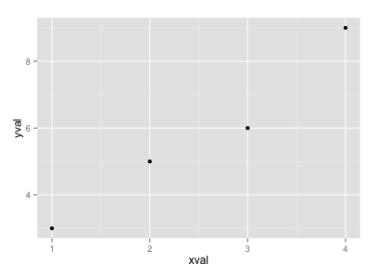
A simple scatter plot

Slide 6
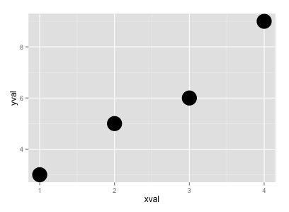
Altering point size

Slide 7

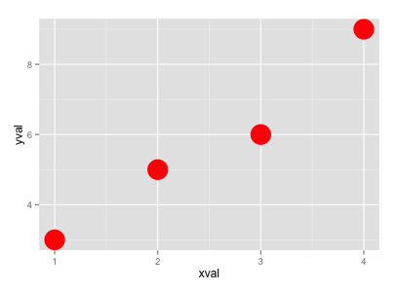
Altering point colour

Slide 8

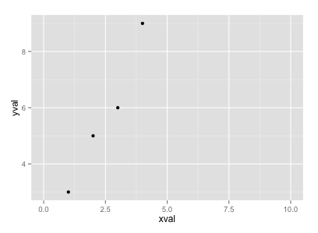
Changing Scales

Slide 9

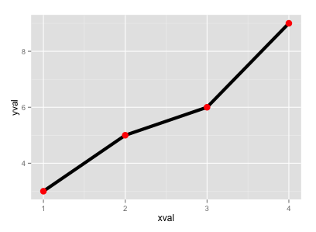
Showing points and lines

Slide 10

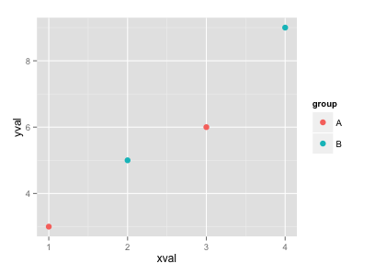
Colouring points by group.

Slide 11

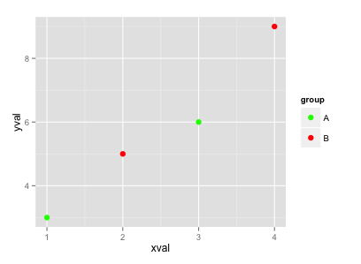
Choosing a different palette

Slide 12
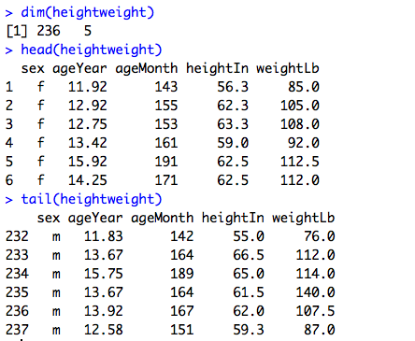
(2) Exploring more detailed plots library(gcookbook)

Slide 13
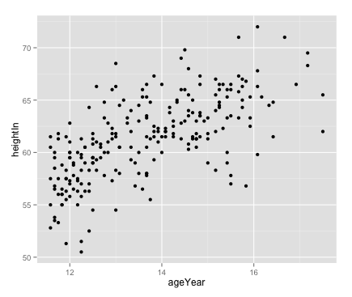

Plotting scatter plot

Slide 14
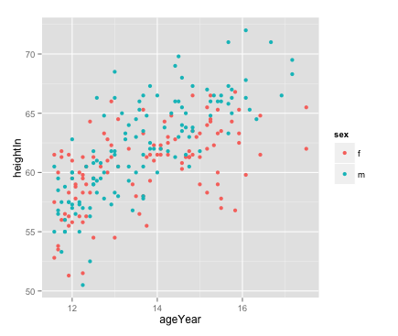

Plots by male/female

Slide 15
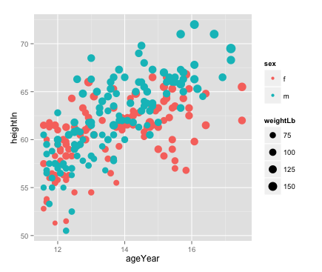

Data using colour and size, points scaled

Slide 16
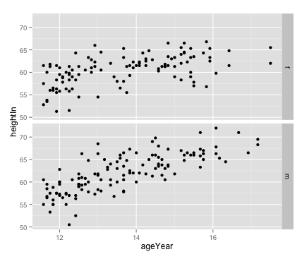

Comparing gender using facet_grid()

Slide 17
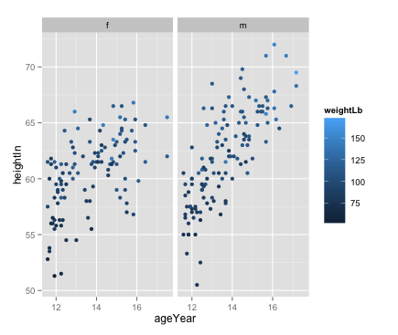

facet_grid(), with continuous variable

Slide 18
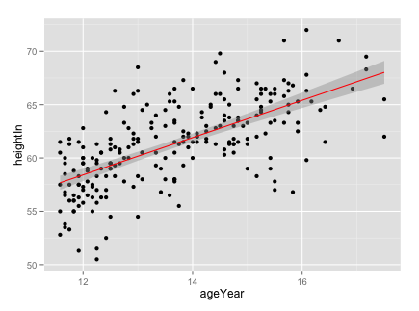
Layering on a statistical model

Slide 19
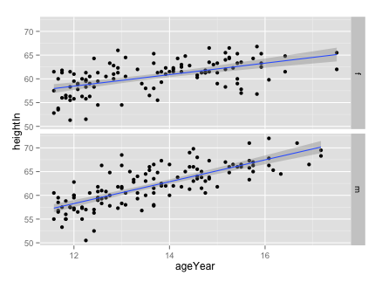

Comparing two linear models

Slide 20
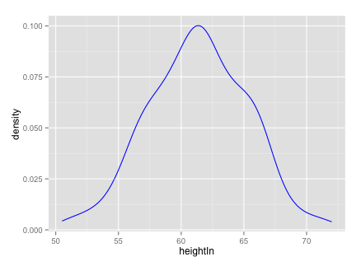

Creating a density curve from continuous data

Slide 21
Measures of Association Sample Pearson Correlation Coefficient
The quantitative measure of the strength in the linear relationship between two variables
The values of r can range from a perfect positive correlation of 1, to a perfect negative correlation of -1
Care should be taken when interpreting results, just because two variables are correlated does not guarantee a cause and effect situation
Assumption that data follows a normal distribution

Slide 22
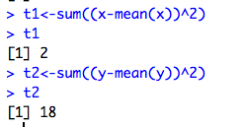
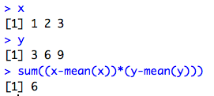

Example (where r should be = 1)

Slide 23
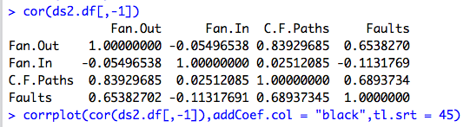
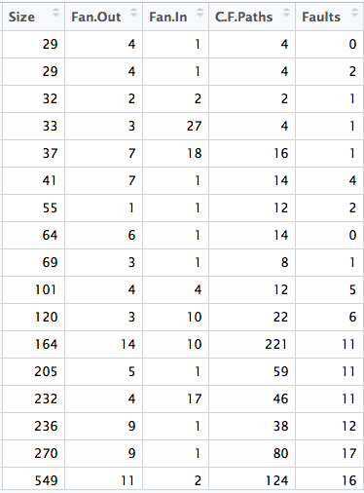
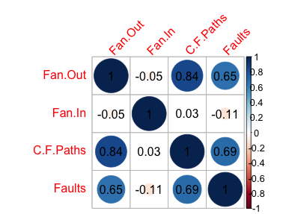

Slide 24
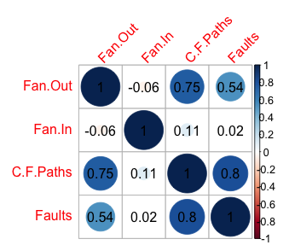
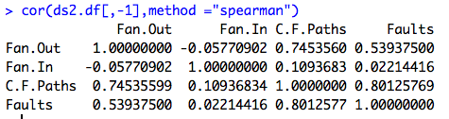
Robust correlation Spearman’s rank correlation coefficient
For non-normally distributed data, preferable to use robust measures of association (ranking)

Slide 25
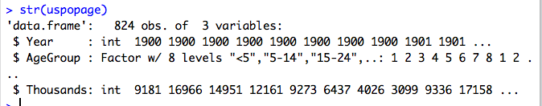
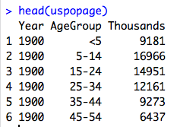
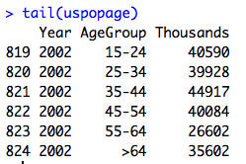
Area Graphs

Slide 26

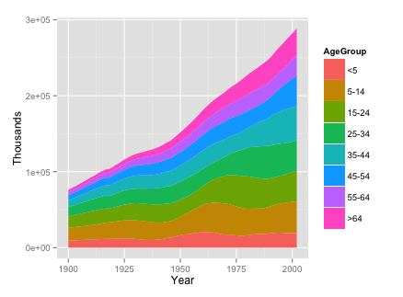
geom_area()

Slide 27
Challenge 11.1
Create a stacked area graph of the Irish population, based on the following data from the CSO website

Slide 28
